Slide 1
Thought experiment static int y = 0;
int main(int argc, char **argv)
{
extern int y;
y = y + 1;
return 0;
}

Slide 2
Thought experiment static int y = 0;
int main(int argc, char **argv)
{
extern int y;
y = y + 1;
return 0;
}
Upon completion of main, y == 1

Slide 3
Thought experiment (continued) static int y = 0;
Program 1
int main(int argc, char **argv)
{
extern int y;
y = y + 1;
return 0;
}
Program 2
int main2(int argc, char **argv)
{
extern int y;
y = y - 1;
return 0;
}
Assuming both programs run “in parallel,” what are possible values of y on completion?

Slide 4
Fundamental Assumption
On (nearly) all computers, reading and writing of machine words are each atomic
    Non-interruptible
    Appearing to take zero time
    Not in conflict with any other operation
No other guarantees
    (except for extraordinary measures)

Slide 5
Definitions
Definition: race condition
    When two or more concurrent activities are trying to change the same variable inconsistently
    Random outcome
Critical Region (aka critical section)
    One or more fragments of code that modify the same data, such that at most one activity at a time can be executing anywhere in that set of fragments.

Slide 6
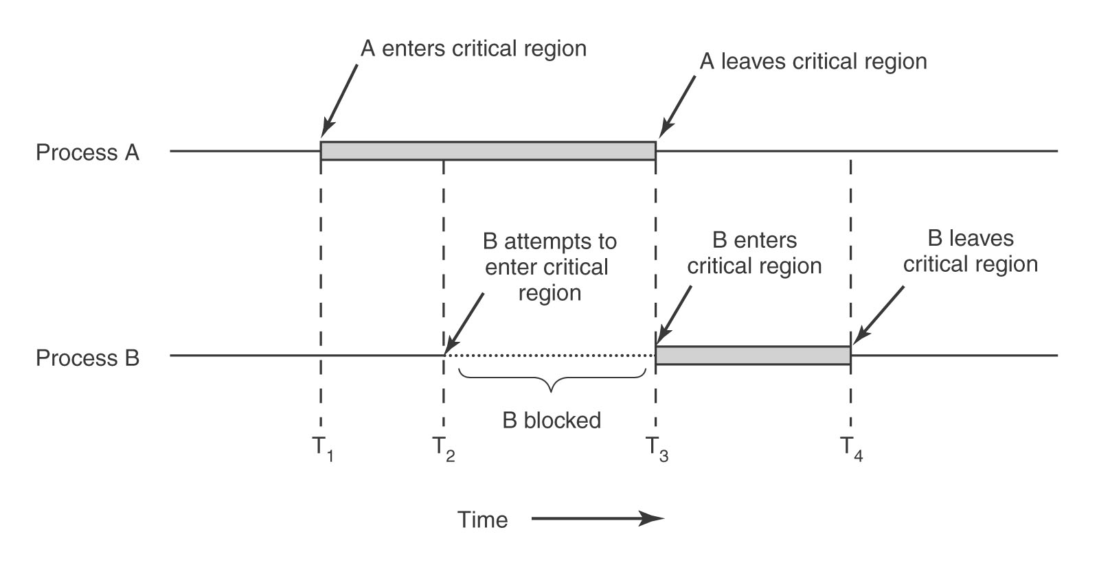
Synchronization – Critical Regions
Tannenbaum, page 103

Slide 7
Class Discussion
How do we keep multiple computations from being in a critical region at the same time?
    Especially when number is > 2

Slide 8
Possible ways to protect a critical section
Without OS assistance — Locking variables & busy waiting
    Peterson’s solution (p. 105)
    Atomic read-modify-write – e.g. Test & Set
With OS assistance on single processor
    Disable interrupts
    Mutex (Mutual Exclusion)
    Semphores
    Monitors
    Barrier synchronization
What about multiple processors?
    Shared memory
    Non-shared memory

Slide 9
Requirements for
Controlling Access to a Critical Section
  Symmetrical among n computations
  No assumption about relative speeds
  A stoppage outside critical section does not lead to potential blocking of others
  No starvation — i.e. no combination of timings that would cause a computation to wait forever to enter its critical section

Slide 10
Non-solution static int turn = 0;
Computation 1
while (TRUE) {
while (turn !=0)
/*loop*/;
critical_region();
turn = 1;
noncritical_region();
};
Computation 2
while (TRUE) {
while (turn !=1)
/*loop*/;
critical_region();
turn = 0;
noncritical_region();
};

Slide 11
Non-solution static int turn = 0;
Computation 1
while (TRUE) {
while (turn !=0)
/*loop*/;
critical_region();
turn = 1;
noncritical_region();
};
Computation 2
while (TRUE) {
while (turn !=1)
/*loop*/;
critical_region();
turn = 0;
noncritical_region();
};
What is wrong with this approach?

Slide 12
Peterson’s solution static int turn = 0; static int interested[2];
void enter_region(int process) {
int other = 1 - process;
interested[process] = TRUE;
turn = process;
while (turn == process &&
interested[other] == TRUE)
/*loop*/;
};
void leave_region(int process) {
interested[process] = FALSE;
};

Slide 13
Exercise
Can Peterson’s solution be generalized to more than 2 concurrent computations?
    This will be a brief class discussion at the beginning of class next week.

Slide 14
Test & Set Instruction static int lock = 0;
extern int TestAndSet(int &i);
/* sets the value of i to 1 and returns the previous value of i. */
void enter_region(int process) {
while (TestAndSet(lock) == 1)
/* loop */ ;
};
void leave_region(int process) {
lock = 0;
};

Slide 15
Test & Set Instruction static int lock = 0;
extern int TestAndSet(int &i);
/* sets the value of i to 1 and returns the previous value of i. */
void enter_region(int process) {
while (TestAndSet(lock) == 1)
/* loop */ ;
};
void leave_region(int process) {
lock = 0;
};
What is wrong with this solution?

Slide 16
Semaphores
In the OS, implement
    A data type called semaphore with integer values.
    An operation DecrOrBlock(semaphore &s) such that
      if s > 0, atomically decrement s and proceed.
      if s <= 0, block the computation until some other computation executes IncrAndUnblock(s).
    An operation IncrAndUnblock(semaphore &s):–
      Atomically increment s; if one or more computations are blocked on s, allow precisely one of them to unblock and proceed.

Slide 17
Critical Section Control with a Semaphore static semaphore mutex = 1;
Computation 1
while (TRUE) {
DecrAndBlock(mutex);
critical_region();
IncrAndUnblock(mutex);
noncritical_region1();
};
Computation 2
while (TRUE) {
DecrAndBlock(mutex);
critical_region();
IncrAndUnblock(mutex);
noncritical_region2();
};

Slide 18
Practical example – n-way buffering
#define N 3 /* number of items in buffer*/ buffer B[N]; semaphore full = 0; semaphore empty = N;
Producer
void addItem(buffer &b) {
static int i = 0;
DecrOrBlock(empty);
B[i] = b;
i++;
IncrAndUnblock(full);
};
Consumer
void removeItem(buffer &c){
static int j = 0;
DecrOrBlock(full);
c = B[j];
j++;
IncrAndUnblock(empty);
};

Slide 19
Semaphores – History
Introduced by E. Dijkstra in 1965.
DecrOrBlock() was called P()
    Initial letter of a Dutch word meaning “test”
IncrAndUnblock() was called V()
    Initial letter of a Dutch word meaning “increase”

Slide 20
Abstractions
The semaphore is an example of a new and powerful abstraction defined by the OS
    I.e., a data type and some operations that add a capability that was not in the underlying hardware or system.
Once available, any program can use this abstraction to control critical sections and more powerful forms of synchronization among computations.

Slide 21
Summary – Week 1
What is an OS?
Concurrency
Abstractions

